Slide 1
Deep Architectures For Real-Time People Counting
Purimetla Naresh Babu
Bachelor of technology
Electronics and communication engineering
(18EC01003)
Under the guidance of
Dr. N. B. Puhan
IIT BHUBANESWAR
SCHOOL OF ELECTRICAL SCIENCES

Slide 2
Table of contents
Introduction
Objective
Methodology and Implementation
3.1)Event Classification Model
3.2)Dataset
3.3)Results
4. Methodology and Implementation
4.1)Object detection
4.2)pipeline for working
SCHOOL OF ELECTRICAL SCIENCES

Slide 3
Table of Contents
4.3)Data preparation
4.3.1)preprocessing
4.4)Training the Model
4.4.1)Yolo_PC
4.4.1.1)yolo v1
4.4.1.2)yolo v3
4.4.2)MobileNet-SSD
4.4.2.1)MobileNet
4.4.2.2)Single shot object detection(SSD)
5. Results and flask implementation
6.Conclusion
7.References

Slide 4
Introduction
A vision-based people counter is often used in video surveillance, urban planning, resource management, and consumer profiling applications to compute the number of people entering and exiting a specific region for a given image.
In public venues where people gather and wait, such as bus stops, subway platforms, and waiting rooms, crowd control is critical. The demand for automatically counting individuals in surveillance settings with a significant population, such as train stations, shopping malls, and tourist attractions, is increasing in the intelligent surveillance industry.
SCHOOL OF ELECTRICAL SCIENCES

Slide 5
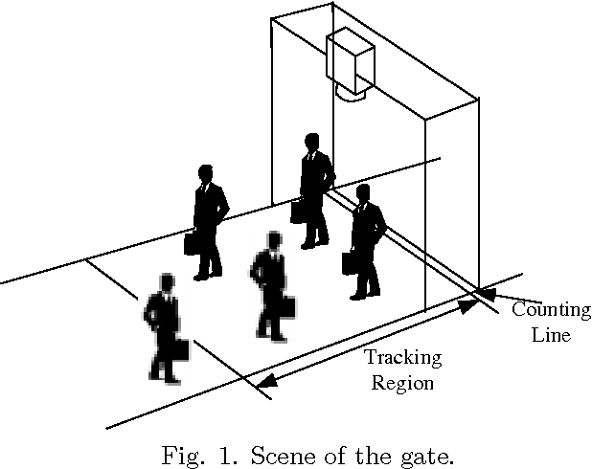
Objective-Why??
A inability to control crowd flow and traffic movement in public locations was the root of almost every major stampede. Such challenges could be avoided with the use of intelligent surveillance systems with crowd counting capabilities.
When the number of people in a public location reaches a dangerous level, management departments can be notified right once and take steps to limit crowd flow by adding new exits, closing entrances, or assigning more staff to oversee traffic flows.
SCHOOL OF ELECTRICAL SCIENCES

Slide 6
Methodology-1 Event Classification
The problem of people counting is transformed into an event classification problem for a particular input frame using the Model.
CNN-based people counter is proposed. Subsequently, the proposed CNN was trained using input frame cubes with their labelled classes, which can deliver an accurate instantaneous people count by classifying a given input frame into a specific event representing people’s entrance and exit situations.
For a current input frame cube consisting of the t-2th–t+2th frames, the proposed CNN provides three consecutive output classes that describe the entrance and exit situations of the input frames
SCHOOL OF ELECTRICAL SCIENCES

Slide 7
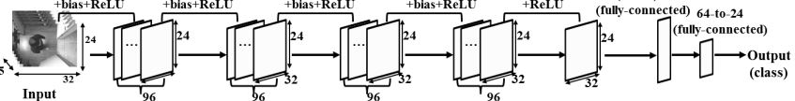
Architecture
Fig-2:CNN-based people counter using Classification
SCHOOL OF ELECTRICAL SCIENCES

Slide 8
Implementation
The projected CNN’s output is divided into eight categories. For the output representation, just one hot encoding was employed, resulting in an 8:1 output vector for the proposed CNN. The probability of eight different sorts of classes are represented by each member of the output vector.
The SoftMax function is used for extracting the final output vector that indicates to which class the input frame cube belongs. The cost function for the training of the proposed CNN is defined using the cross entropy
SCHOOL OF ELECTRICAL SCIENCES

Slide 9
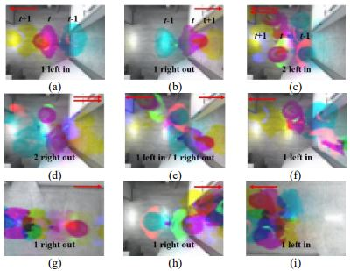
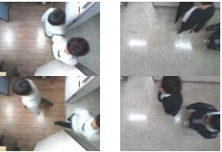
Implementation
Fig-3: Example of input frames at the time of counting the number of entering or exiting people
Fig-4: Images in people overhead dataset
SCHOOL OF ELECTRICAL SCIENCES

Slide 10
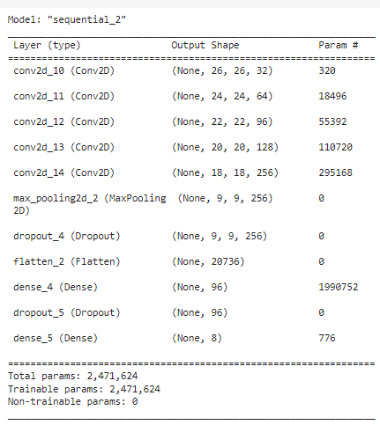
Architecture and Hyperparameters
parameter | Value
Optimizer | Adam
Loss function | Categorical cross entropy
Batch size | 30
epochs | 500
Learning rate | 0.0001
Table1: Hyper Parameters
Fig 5: Model Architecture
SCHOOL OF ELECTRICAL SCIENCES

Slide 11
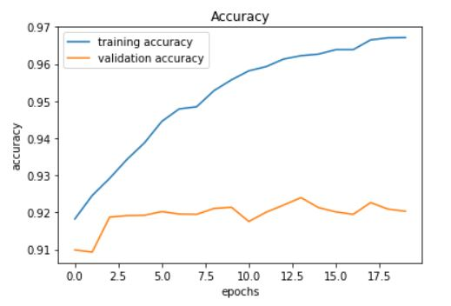
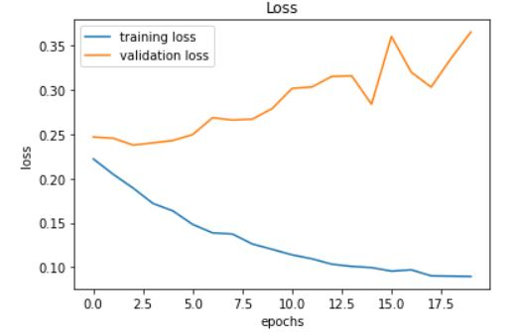
Results
Training set consists of 2400 images consisting of all class images. The testing set consists of 600 images
This model achieved 96.6% training accuracy and 92.14% cross-validation accuracy.
Fig 6: Accuracy v/s Epochs
Fig 7: loss v/s Epochs
SCHOOL OF ELECTRICAL SCIENCES

Slide 12
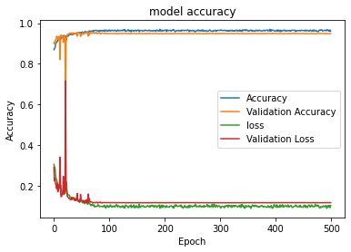
Fig 8: Accuracy v/s Epochs

Slide 13
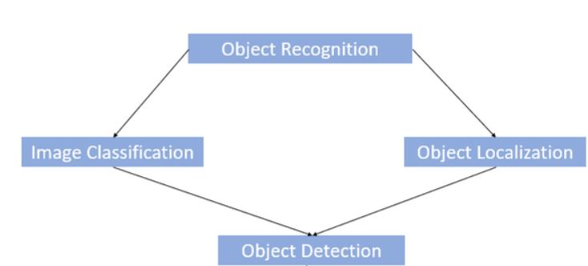
Object Detection
Object detection is a computer technology related to computer vision and image processing that deals with detecting instances of semantic objects of a certain class (such as humans, buildings, or cars) in digital images and videos and automatically create bounding boxes on those objects.
Fig 9 : Flow diagram of object detection

Slide 14
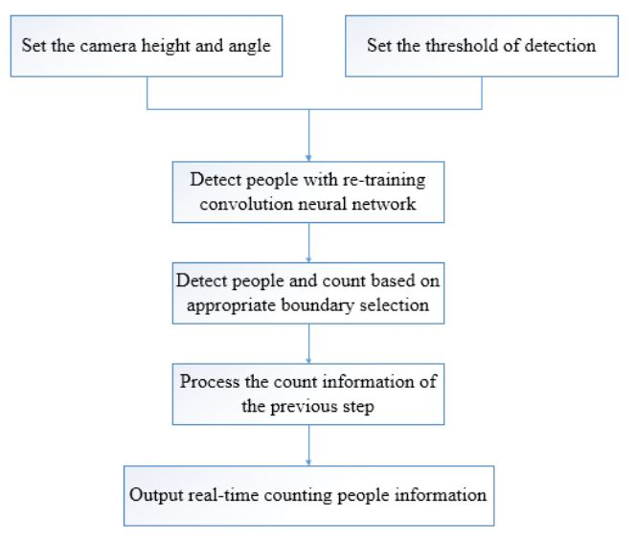
Object detection
Fig 10: real-time people counting using object detection models
SCHOOL OF ELECTRICAL SCIENCES

Slide 15
Data Preperation
The Town-Centre dataset has Annotations and ground truths for 3090 frames of 7502 frames, so I used those frames for creating train and Val images and the rest for test images.
The Town-Centre data consist of two things:
TownCentreXVID.mp4: It is a 15 min video of the town center with pedestrians walking.
TownCentre-groundtruth : It is a CSV format-annotations for 3090 frames with (x1,y1),(x2,y2) of bounding boxes.(Note: (xmin,ymin) (xmax,ymax) not specified).

Slide 16
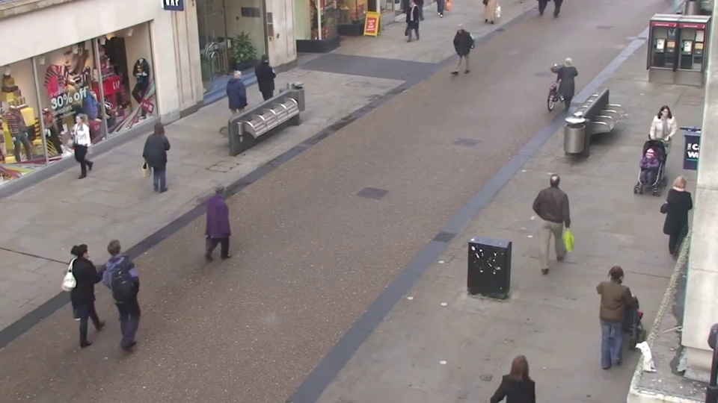
Dataset
Fig 11: Image Frame in Town-Centre Dataset

Slide 17
Pre-Processing
The images that the standard datasets contain and the images that are obtained in real life have a huge variation in the illumination as the lighting conditions of the surroundings vary. for the better performance of the model we need to train the model with all kinds of images
In my case, I had 3090 images for training and by using the available data I made the Augmented data and ultimate df so that I can use my custom data and train any model with all kinds of variations. To achieve this we should have our annotations in 3 formats :
• TF.record() format
• CSV format
• XML format

Slide 18
Pre-Processing
Steps:
1. Creating image data frame.
2. Creating XML data frame.
3. Making the ultimate data frame by merging the two.
4. Making augmented dir in the common path.
5. Making XML for augmented images.
6. Similarly, like 1,2,3 making ultimate aug ultimate D

Slide 19
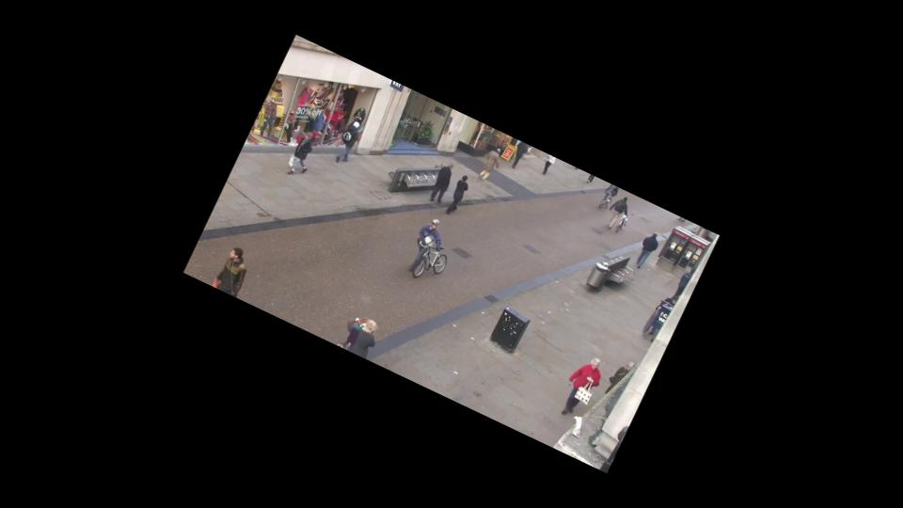
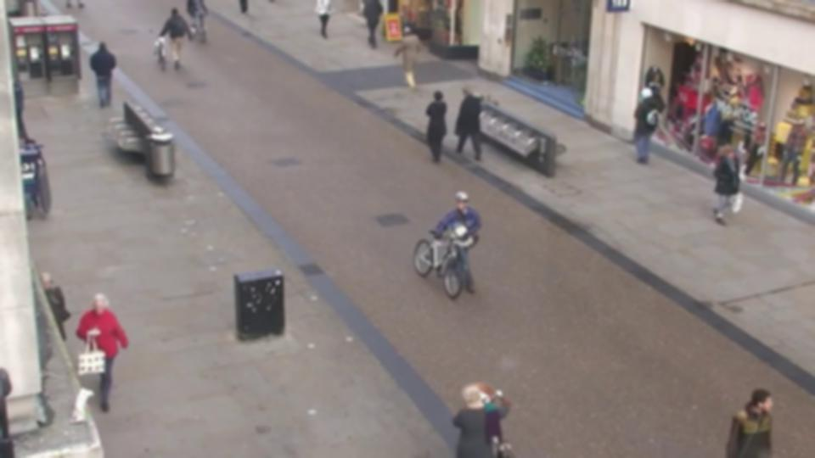
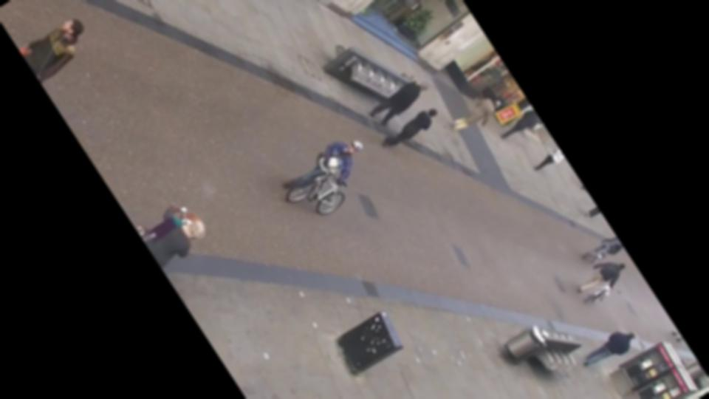
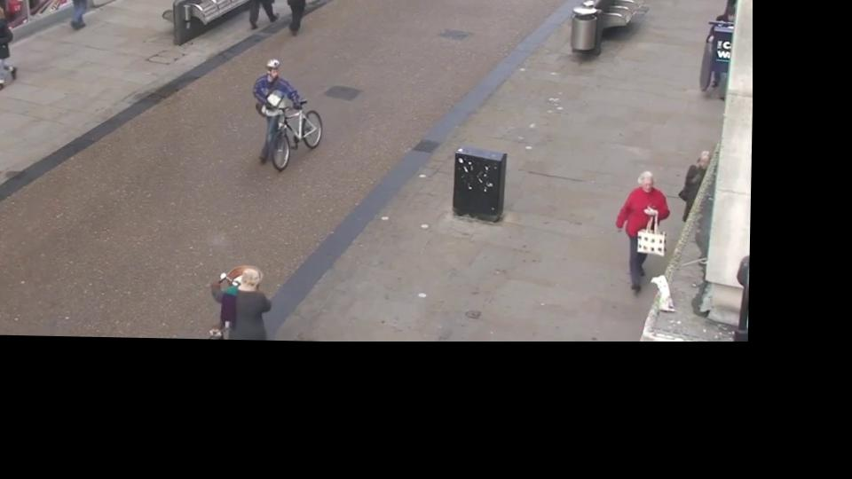
Fig 12: Augmented Images

Slide 20
Methodology- YOLO_PC
YOLO, A single convolutional network simultaneously predicts multiple bounding boxes and class probabilities for those boxes.
B bounding boxes and confidence scores for those boxes are predicted for each grid cell. These confidence scores represent the model’s belief that the box contains an object, as well as the accuracy with which it believes the box it predicts is.
The confidence ratings should be zero if there is no object in that cell. Otherwise, we want the confidence score to be equal to the IOU between the forecast box and the ground reality
SCHOOL OF ELECTRICAL SCIENCES

Slide 21
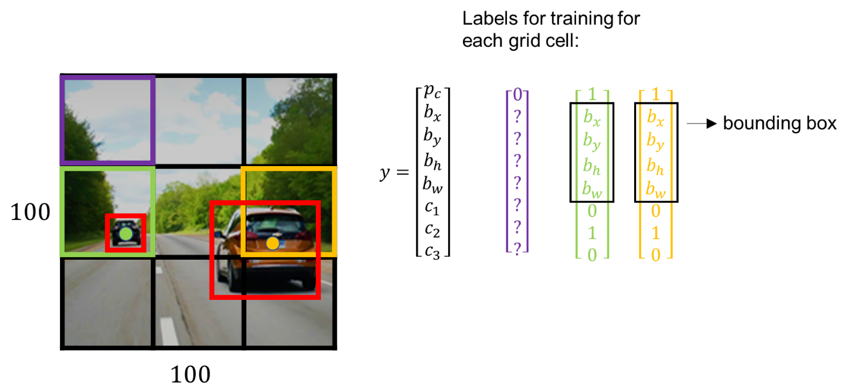
YOLO
Fig 14: YOLO Anchor box output
SCHOOL OF ELECTRICAL SCIENCES

Slide 22
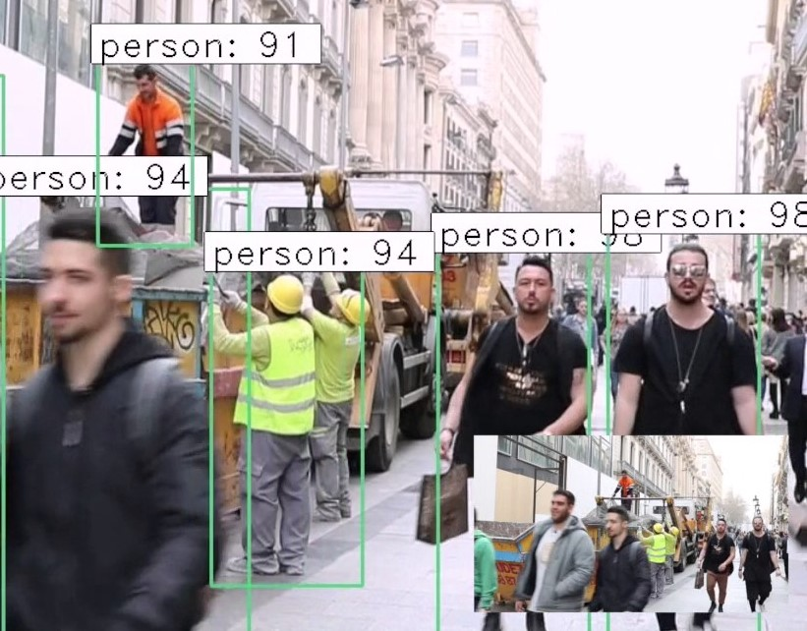
YOLO_PC
YOLO-PC extends the original YOLO system using a deep learning approach to achieve more accurate people counting. The Darknet neural network framework is used for training and testing

Slide 23
Yolo v1
YOLOV1 is an extremely fast object detection technique that processes images in real-time at 45 frames per second. YOLO is pretty simple. A single convolutional network simultaneously predicts multiple bounding boxes and class probabilities for those boxes.
It employs the Darknet framework, which was trained on the ImageNet-1000 dataset
Unlike other detection techniques, which use a sliding window to extract features, YOLO sees the entire image during training and test time as a result of which it can encode contextual information about the classes as well as their appearance.
YOLO makes less than half the number of background errors compared to Fast R-CNN.

Slide 24
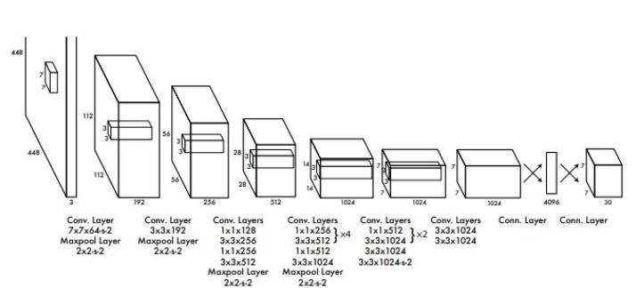
Yolo V1
Fig 15: Yolo V1 Architecture

Slide 25
Yolo v1 Limitations
The primary challenge is object localization in the input image. YOLO imposes strong spatial constraints on bounding box predictions since each grid cell only predicts two boxes and can only have one class.
This spatial constraint limits the number of nearby objects that the model can predict, It was unable to locate small objects that looked like a cluster.
This architecture had problems generalizing images of objects with dimensions other than those of the trained image.

Slide 26
Yolo V3
YOLO v3 represents an incremental upgrade to the previous version and provides everything required for accurate real-time object detection and classification.
YOLO v3’s incremental improvements:
1) Bounding Box Predictions: In YOLO v3, the score for each object’s bounding box is displayed.
2) Class Predictions: In YOLO v3, logistic classifiers are used for each class instead of softmax, which was utilized in YOLO v2.
This allows for multi-label classification in YOLO v3.
3) Feature Pyramid Networks (FPN): YOLO v3 creates predictions similar to FPN, in which three predictions are created for each place in the input image and features are collected from each prediction.

Slide 27
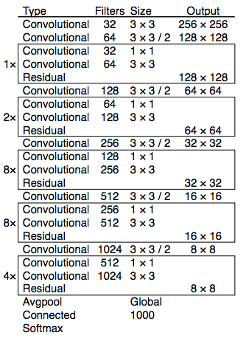
Yolo v3
Darknet-53: although YOLO v2 used Darknet-19 as a feature extractor, YOLO v3 employs the 53-convolutional-layer Darknet-53 network as a feature extractor
Fig 11: Darknet-53

Slide 28
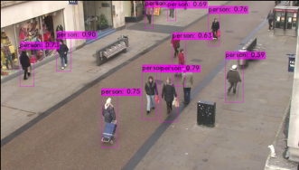
Yolo results
Fig 16: Yolo Model Predictions

Slide 29
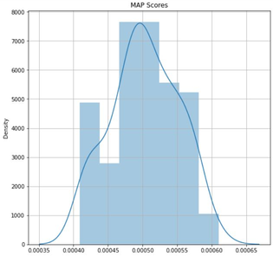
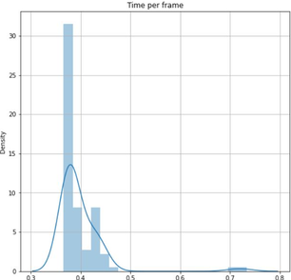
Yolo results
Fig 17: Yolo mAP(45%-58%)
Fig 18: Yolo time per frame(0.43s)

Slide 30
MobileNet-SSD
MobileNet is a lightweight deep neural network architecture designed for mobiles and embedded vision applications. The core layers of MobileNet are built on depth-wise separable filters.
The depthwise convolution of MobileNets applies a single filter to each input channel. The outputs of the depthwise convolution are then combined using a 1×1 convolution by the pointwise convolution
MobileNet uses 3 × 3 depthwise separable convolutions which use between 8 to 9 times less computation than standard convolutions at only a small reduction in accuracy.

Slide 31
Single Short Detector(SSD)
Single shot object detection or SSD takes one single shot to detect multiple objects within the image. The SSD approach is based on a feed-forward convolutional network that produces a fixed-size collection of bounding boxes and scores for the presence of object class instances in those boxes. SSD is designed to be independent of the base
It’s composed of two parts:
1. Extract feature maps
2. Apply convolution filter to detect objects

Slide 32
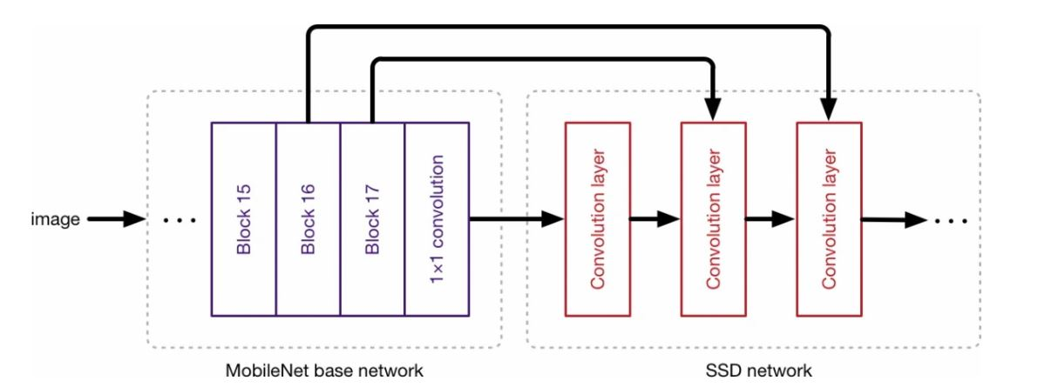
MobileNet-SSD
Fig 19: MobileNet-SSD flow diagram

Slide 33
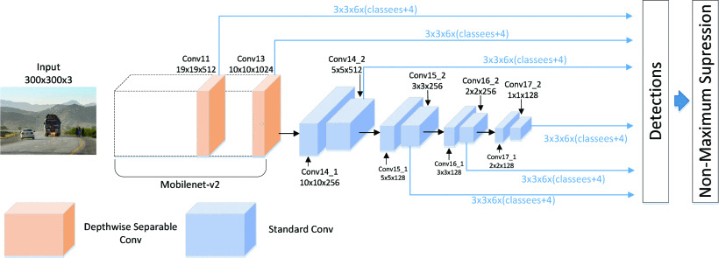
MobileNet-SSD
Fig 20: MobileNet-SSD Architecture

Slide 34
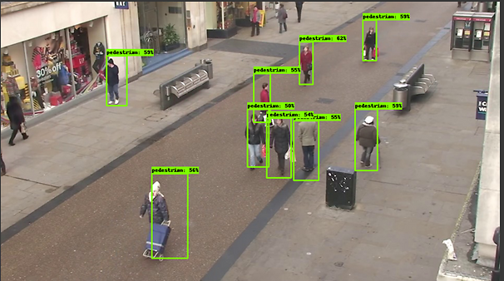
MobileNet-SSD results
Fig 21: MobileNet-SSD Model Predictions

Slide 35
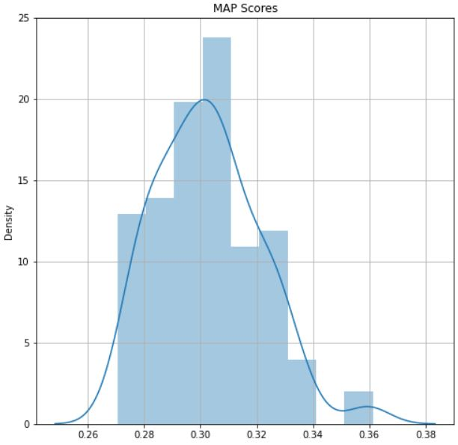
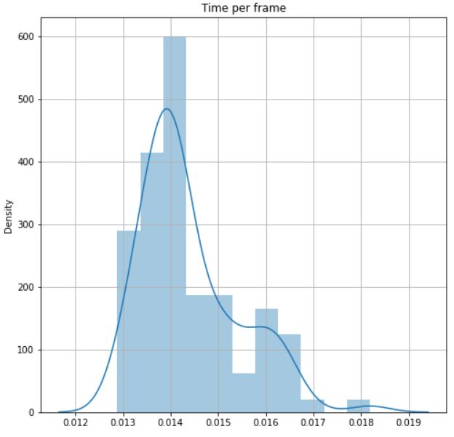
MobileNet-SSD results
Fig 22: MobileNet-SSD mAP(28%-33%)
Fig 23: MobileNet-SSD Time per frame(0.14s)

Slide 36
Model Evaluation
Regarding the criteria that must be considered to distinguish between the two models, there are two such influential parameters which are:
Metrics of evaluation:
1. mAP(Mean Average Precision): Comparing the ground-truth bounding box to the detected box, the mAP yields a score. With a higher score, the model’s detections are more precise.
2. Time-for-prediction(FPS): It is the rate at which your object detection model processes the video and produces the desired result

Slide 37
Model Evaluation
Yolo Results :
mAP of the model is in the range: 45% to 58%
Time per frame: max time : 0.56 sec
min time : 0.42 sec
MobileNet-SSD Results:
mAP of the model is in the range: 28% to 33%
Time per frame: max time : 0.19 sec
min time : 0.13 sec

Slide 38
Flask Implementation
From the above results we can clearly see that the Yolo model is more accurate and speed is comparable with that of the MobileNet-SSD Model, therefore I used Yolo model weights for flask implementation.
I used the cv2.dnn library to download the darknet model and use that to make a prediction for our bounding boxes on the frame.
Each frame can be in 3 stages:
1)Waiting: when no object(person) is in the frame
2)Detecting: when a person enters the frame it starts detecting the person
3)Tracking: after detecting it keeps the tracking the person path and compute changes accordingly

Slide 39
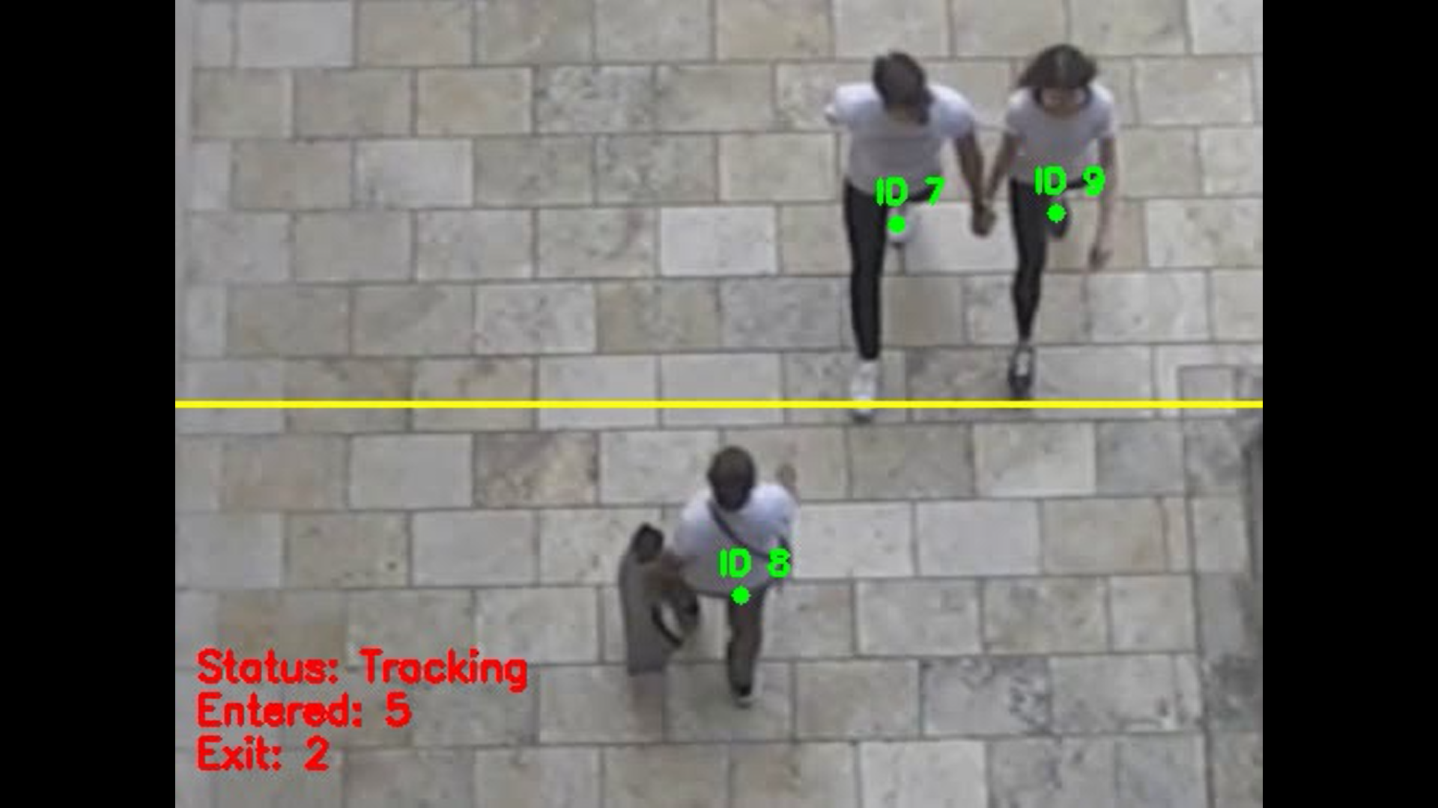
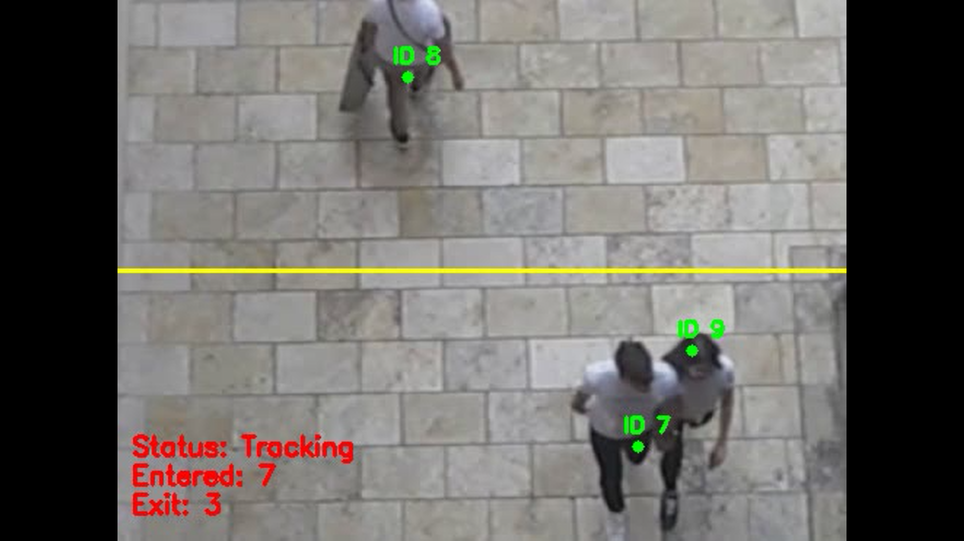
Flask Implementation
Fig 24: Flask interface output giving the total count of people who got in/out before crossing the Line of Interest(LOI)
Fig 25: Flask interface output giving the total count of people who got in/out after crossing the Line of Interest(LOI)

Slide 40
Conclusion
Out of the three architectures implemented (classification model, Yolo, and MobileNet-SSD), Yolo was the most promising. Initially, the problem of people counting was converted to that of event classification where all the possible events are categorized into eight events. This model is tested on overhead data set and this model attained a 92.14% validation accuracy. In our project Considering the advantages of object detection over classification models, we deployed various object detection models like Yolo and MobileNet-SSD.
These object detection models were trained on The Town-Centre dataset which consists of 7000 images along with their ground truths values. In order to obtain a robust model I had 3090 images for training and by using the available data I made the Augmented data. upon training Yolo model has attained a mAp(45%-55%) and it took on average 0.48s for processing one frame whereas the MobileNet-SSD model has attained an mAP(28%-33%) and 0.16s for processing one frame. Considering the importance of accuracy in our project I used obtained Yolo model weights for flask implementation which outputs the number of people got in/out of a particular building/entrance.
SCHOOL OF ELECTRICAL SCIENCES

Slide 41
Future Work
The Project can be further extended to various applications like covid protocols management, and security applications and can be mainly used for business applications including retail analytics, queue management, and utilization applications.
We can also improve the system performance by deploying various upcoming object detection models.

Slide 42
References
[1] Cho, Sung In. "Vision-based people counter using CNN-based event classification." IEEE Transactions on Instrumentation and Measurement 69, no. 8 (2019): 5308-5315.
[2]J. Redmon, S. Divvala, R. Girshick, and A. Farhadi, "You Only Look Once: Unified, Real-Time Object Detection," 2016 IEEE Conference on Computer Vision and Pattern Recognition (CVPR), 2016, pp. 779-788.
[3] Ren, Peiming, Wei Fang, and Soufiene Djahel. "A novel YOLO-Based real-time people counting approach." In 2017 international smart cities conference (ISC2), pp. 1-2. IEEE, 2017.
[4] Bochkovskiy, Alexey, Chien-Yao Wang, and Hong-Yuan Mark Liao. "Yolov4: Optimal speed and accuracy of object detection." arXiv preprint arXiv:2004.10934 (2020).
SCHOOL OF ELECTRICAL SCIENCES

Slide 43
References
[5] Ahmad, M., I. Ahmed, K. Ullah, I. Khan, A. Khattak, and A. Adnan. "Person detection from overhead view: A survey." Int. J. Adv. Comput. Sci. Appl. 10, no. 4 (2019): 567-577.
[6] R. Girshick, "Fast R-CNN," 2015 IEEE International Conference on Computer Vision (ICCV), 2015, pp. 1440-1448, DOI: 10.1109/ICCV.2015.169.
[7]S. Ren, K. He, R. Girshick and J. Sun, "Faster R-CNN: Towards Real-Time Object Detection with Region Proposal Networks," in IEEE Transactions on Pattern Analysis and Machine Intelligence, vol. 39, no. 6, pp. 1137-1149, 1 June 2017, DOI: 10.1109/TPAMI.2016.2577031.
SCHOOL OF ELECTRICAL SCIENCES

Slide 44
THANK YOU
SCHOOL OF ELECTRICAL SCIENCES

